Slide 1
Lending club Case Study
- Akhilesh Dwivedi & Abrar Lohia

Slide 2
Agenda
Objective
Analyse of loan data
Cleaning of data
Identify Key features
Univariate & Bivariate analysis
Derived Metrics
Data Visualisation
Conclusion

Slide 3
Approach
Data Cleaning & Manipulation Checklist
Dropping Rows - where loan_status = "Current"
Dropping Columns based on EDA and Domain Knowledge
Convert the data types
Identify columns with blank values which need to be imputed
Analysis of the dataset post cleanup
Outlier Treatment
Analysis - Univariate, Bivariate and Derived Metrics Analysis
Conclusions Inferences and Recommendations

Slide 4
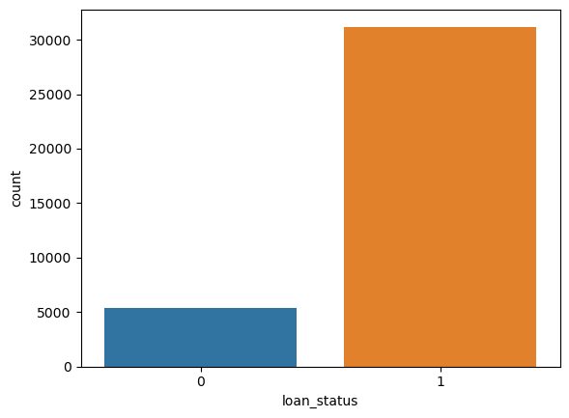
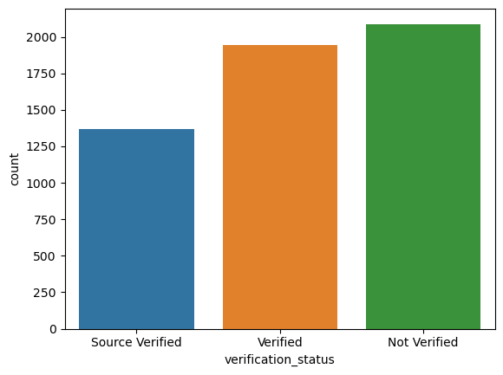
Loan Status and Applicant Verification
0: Charged Off
1: Fully Paid
Loan Charged of are much lesser in comparison to fully paid.
Applicant who’s background is not verified pays loan successfully.

Slide 5
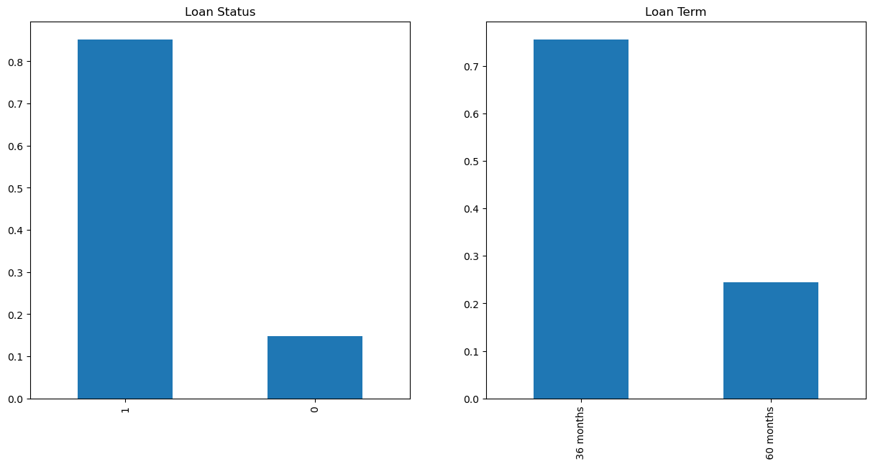
Loan Status & Loan Term Period
0: Charged Off
1: Fully Paid
Here conclusion is those taking for shorter duration clears the loan successfully in comparison for longer duration loan.

Slide 6
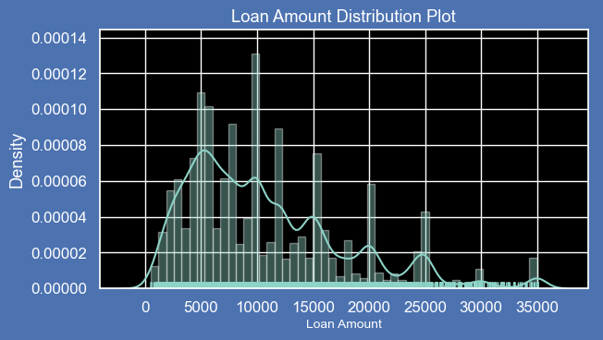
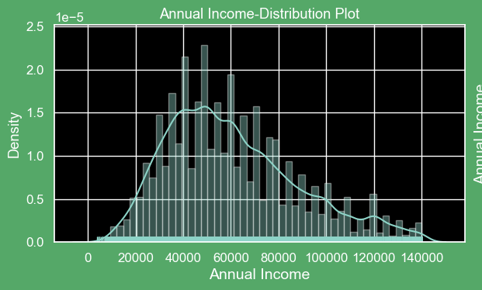
Loan Amount Distribution
Most of the loan amount are given in range of 5K-10K
Most of the loan amount are given to people who are having income between 40K - 80K

Slide 7
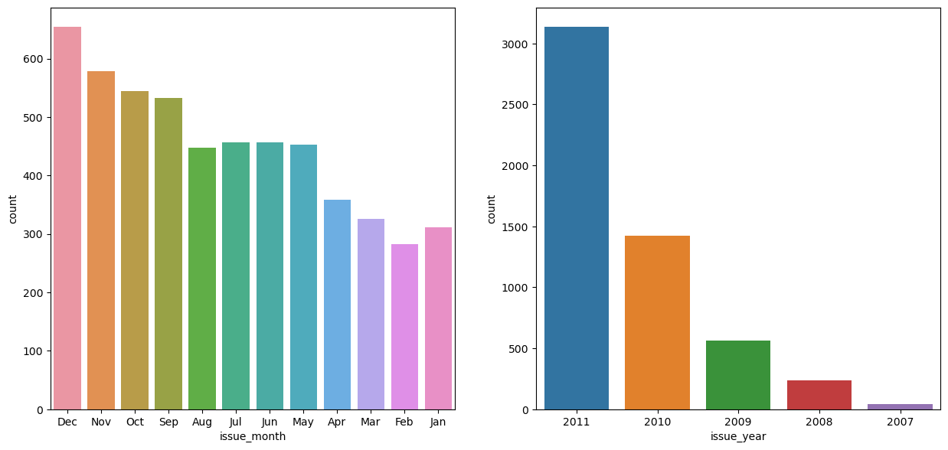
Analyzing Derived Columns
From 2007 till 2011 we can see the spike in loan application.
Another observation we can see is in Jan/Feb/March there are low application count

Slide 8
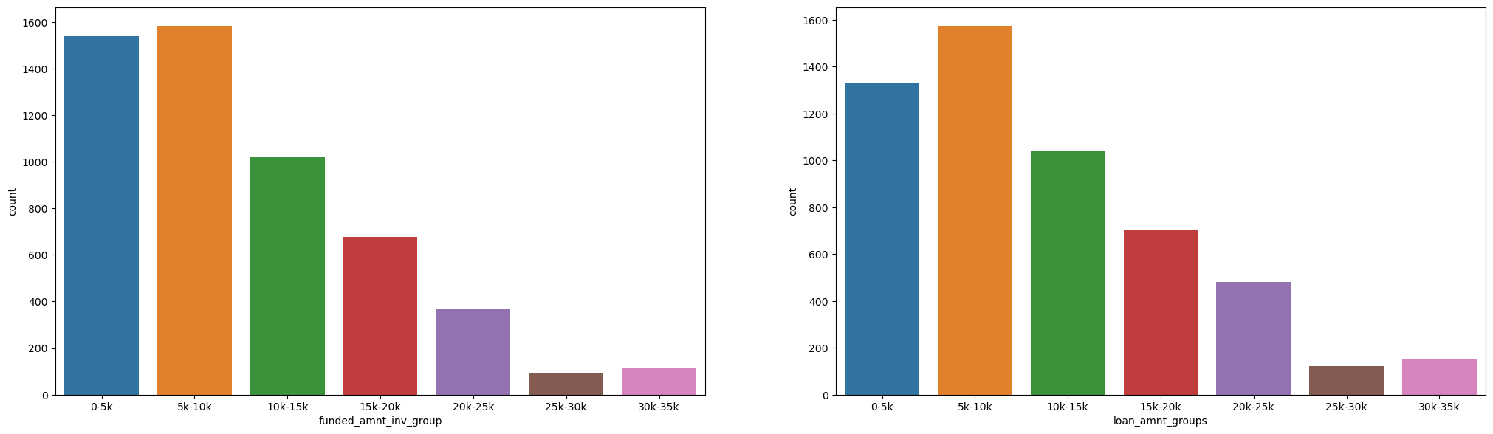
Amount committed by investors & Loan Amount Group
The funded amount by the investor and loan amount given are having maximum in group of 5-10K

Slide 9
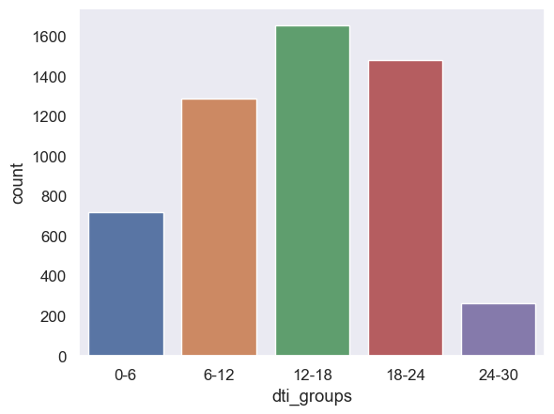
Debt To Income Ratio
Most loan applications have moderate debt to income ratios.

Slide 10
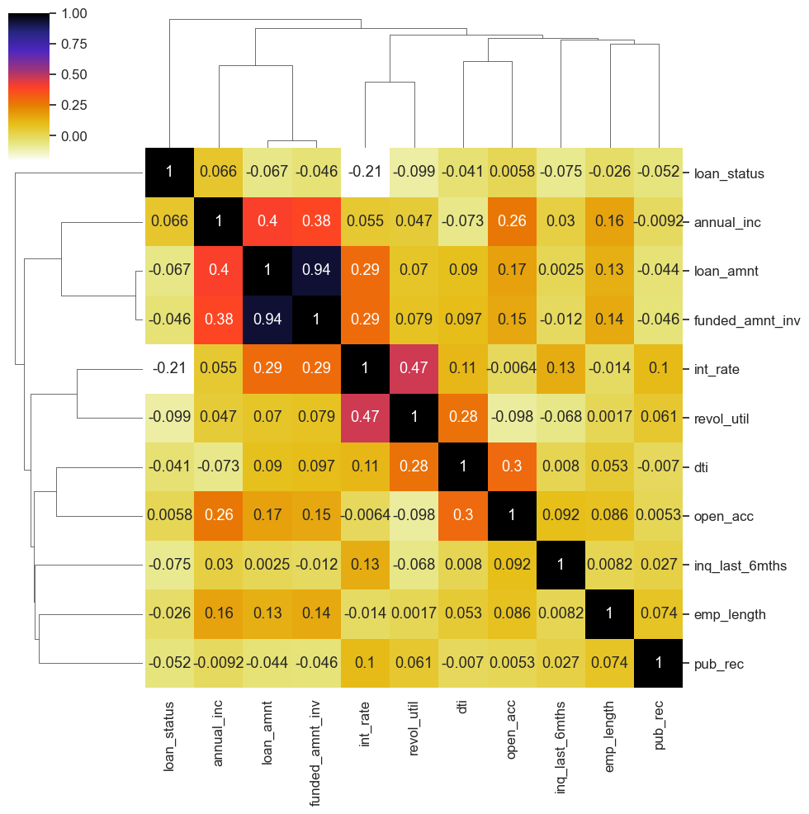
Correlation Analysis
Annual Income to dti Ratio are negatively correlated
Loan Amount,Investor Amount and Funding Amount are strongly correlated
Positive correlation between Annual Income and Employment Length

Slide 11
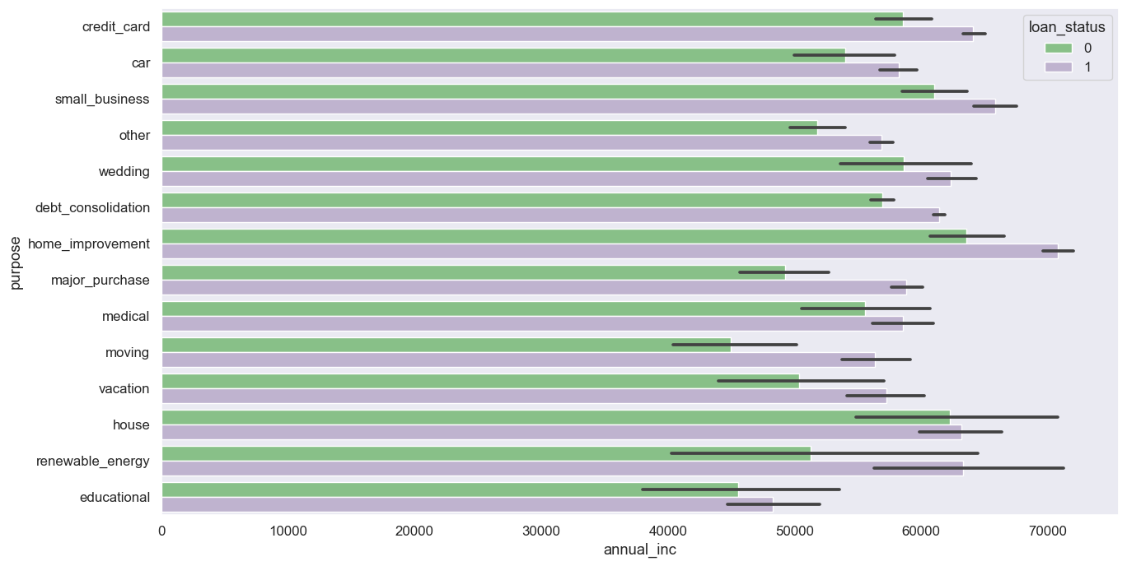
Comparing Annual Income & Loan Purpose
Applicants with higher incomes were more likely to apply for loans for "home_improvement," "house," "renewable_energy," and "small_businesses."

Slide 12
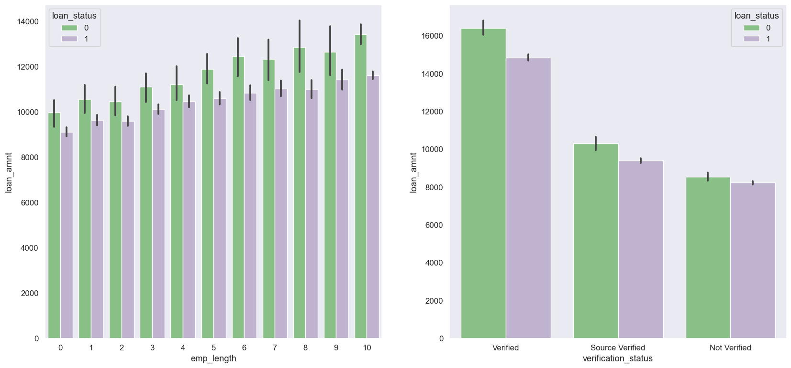
Comparing Employment Period & Verification Status
Verified loan applications had greater loan amounts, according to verification status data. This might imply that the companies are initially checking the loans with greater amounts.

Slide 13
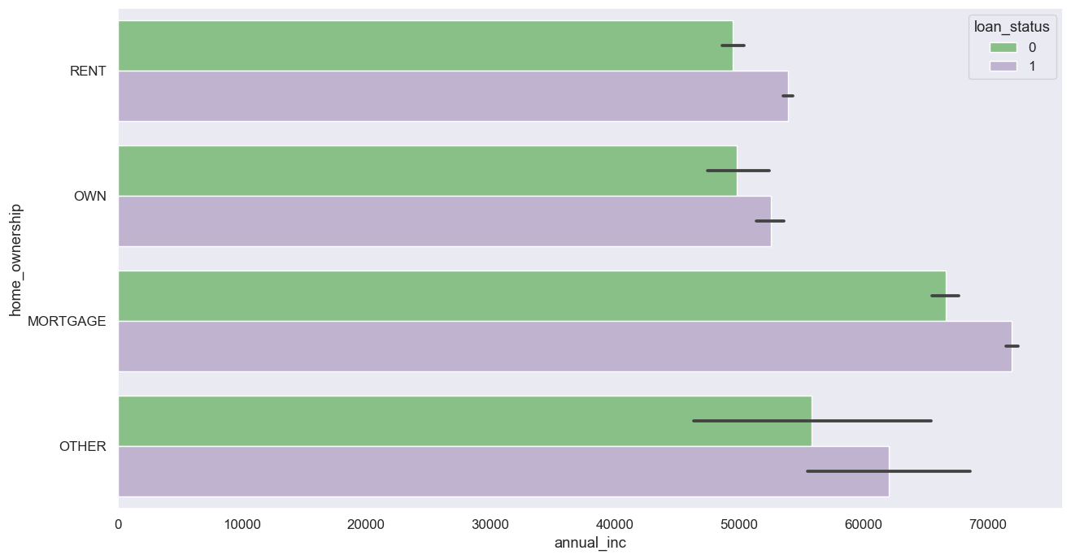
Annual income and home ownership
Applicant having home under mortgage status is the most between range of 15-17.5%

Slide 14
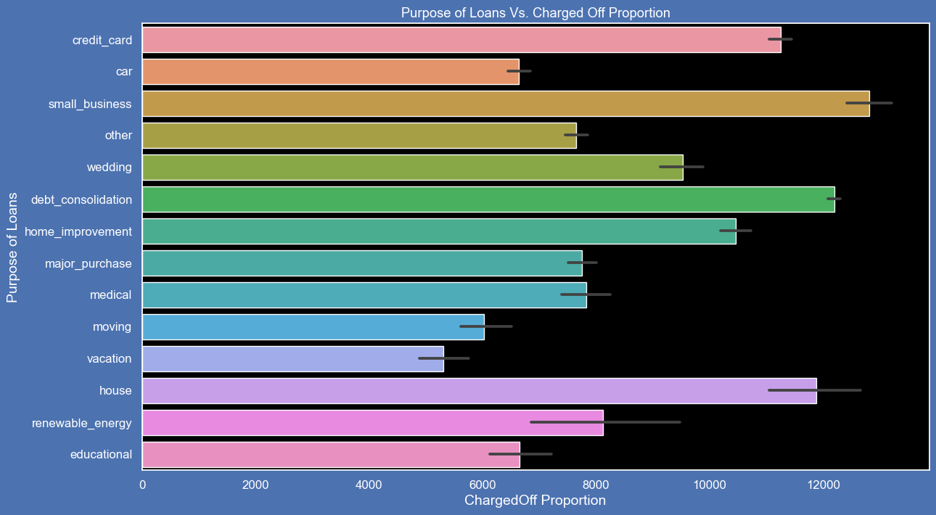
Charged Off vs. Purpose Of Loan
Most of the loan taken for small business have chance to be default

Slide 15
Conclusion
Suggestion for avoiding Credit Loss
Applicant taking loan have income between 60-70K
Applicant having home_ownership status as mortgage have income between 60-70K
Applicant having income ranging 30-35K have interest rate of 15-17.5%
Applicant who have taken home ownership status as mortgage have loan amount between 12-14K
Employees working for more than 10 years and whose souce are verified tend to get loan amount above 16K
Applicant who have taken loan for small buisness have amount greater than 14K
While giving the loan following factors can be taken into account to predict the avoidance of credit loss:
Debt to Income Ratio
Verification Status of applicant
Annual Income of the applicant
Employment Length of the applicant

